Slide 1
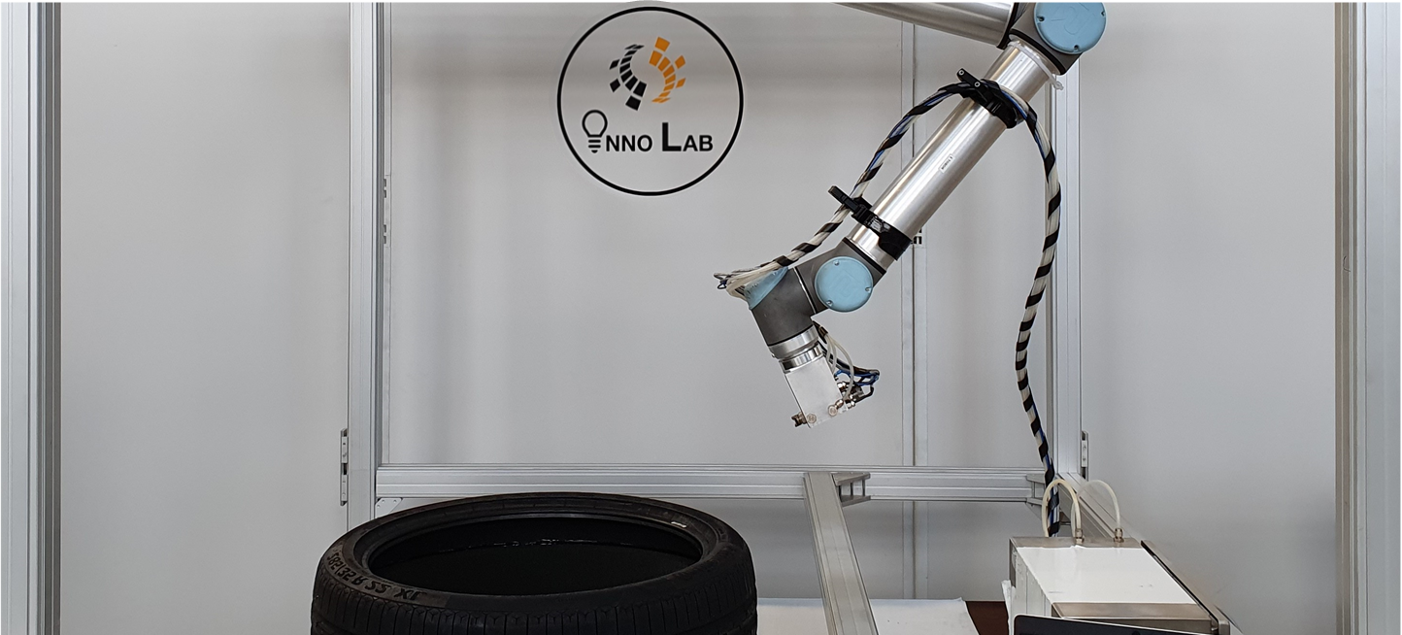
Automatic tire inside spraying
Mechanical integration of COBOT and tool
Software development
by Leon Book and Lion Ratayczak

Slide 2
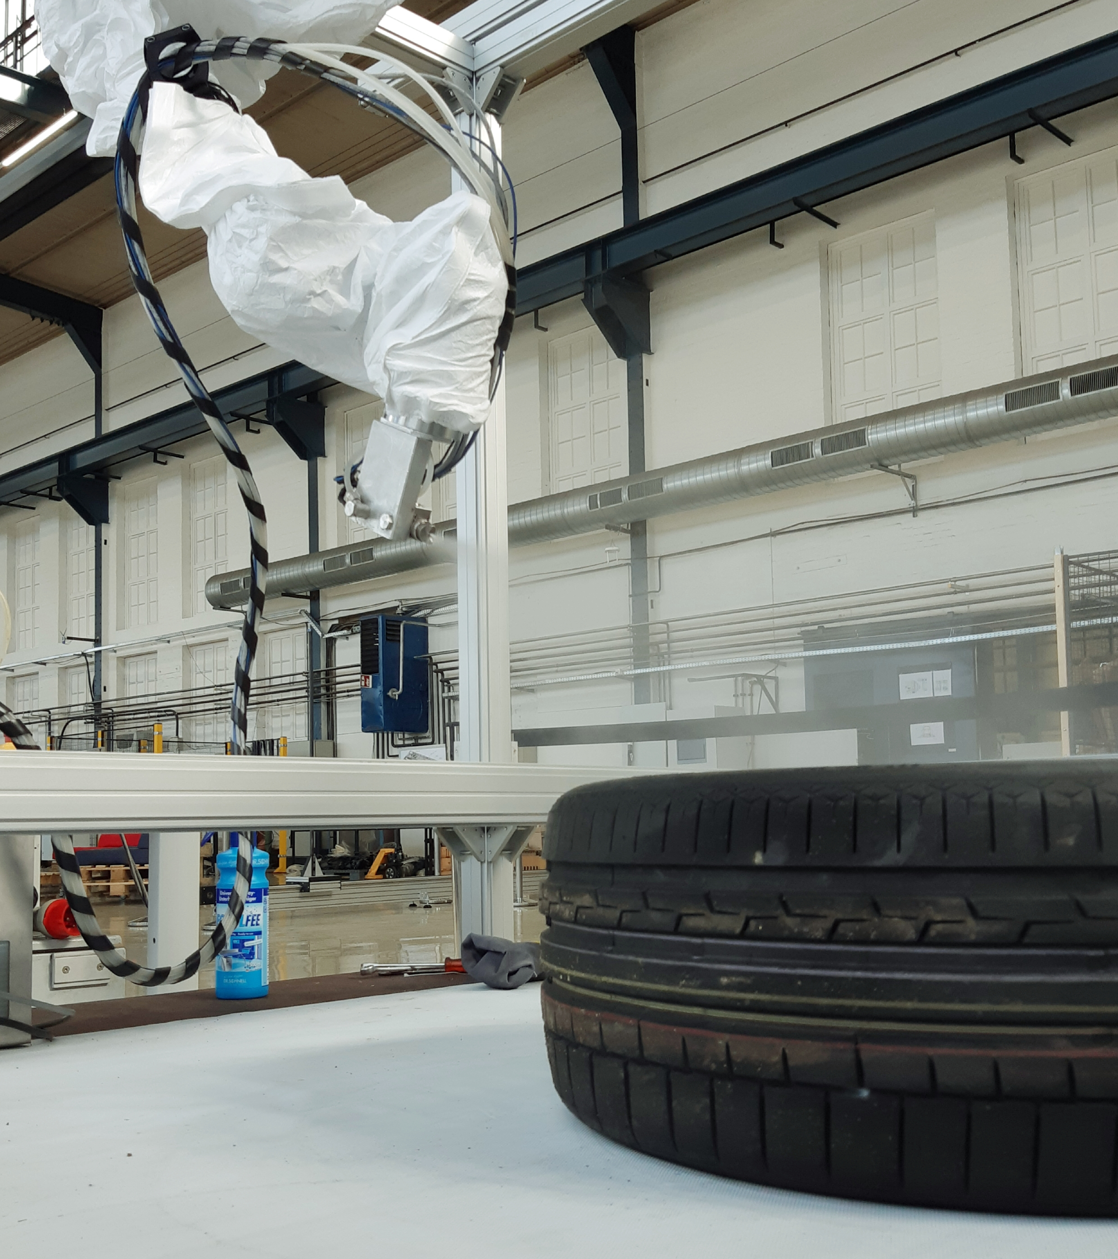
Description
get pressed into the mold by rubber bellows
to prevent a lasting connection between rubber and bellows
→ Spraying with separative fluid
currently tire blanks are sprayed:
in automated systems e.g., with robots, which grab, center and relatively rotate the tire around the spraying tool
by hand, to balance peeks or system failures
the manual work is supposed to be automated
robot which carries the spraying tool
automatic detection of the tire
automatic spraying of a defined area

Slide 3
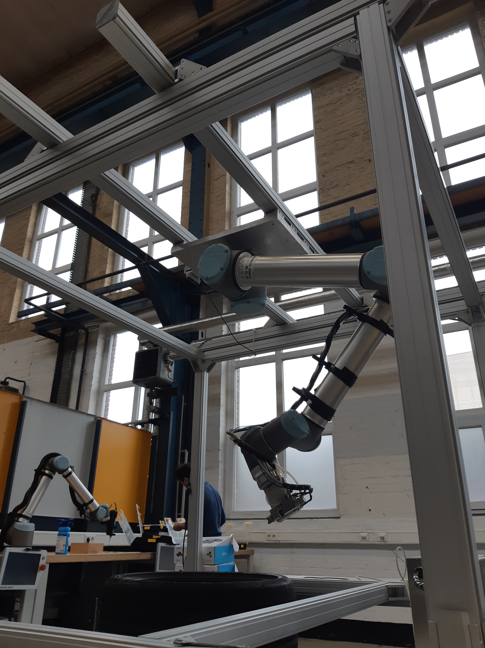
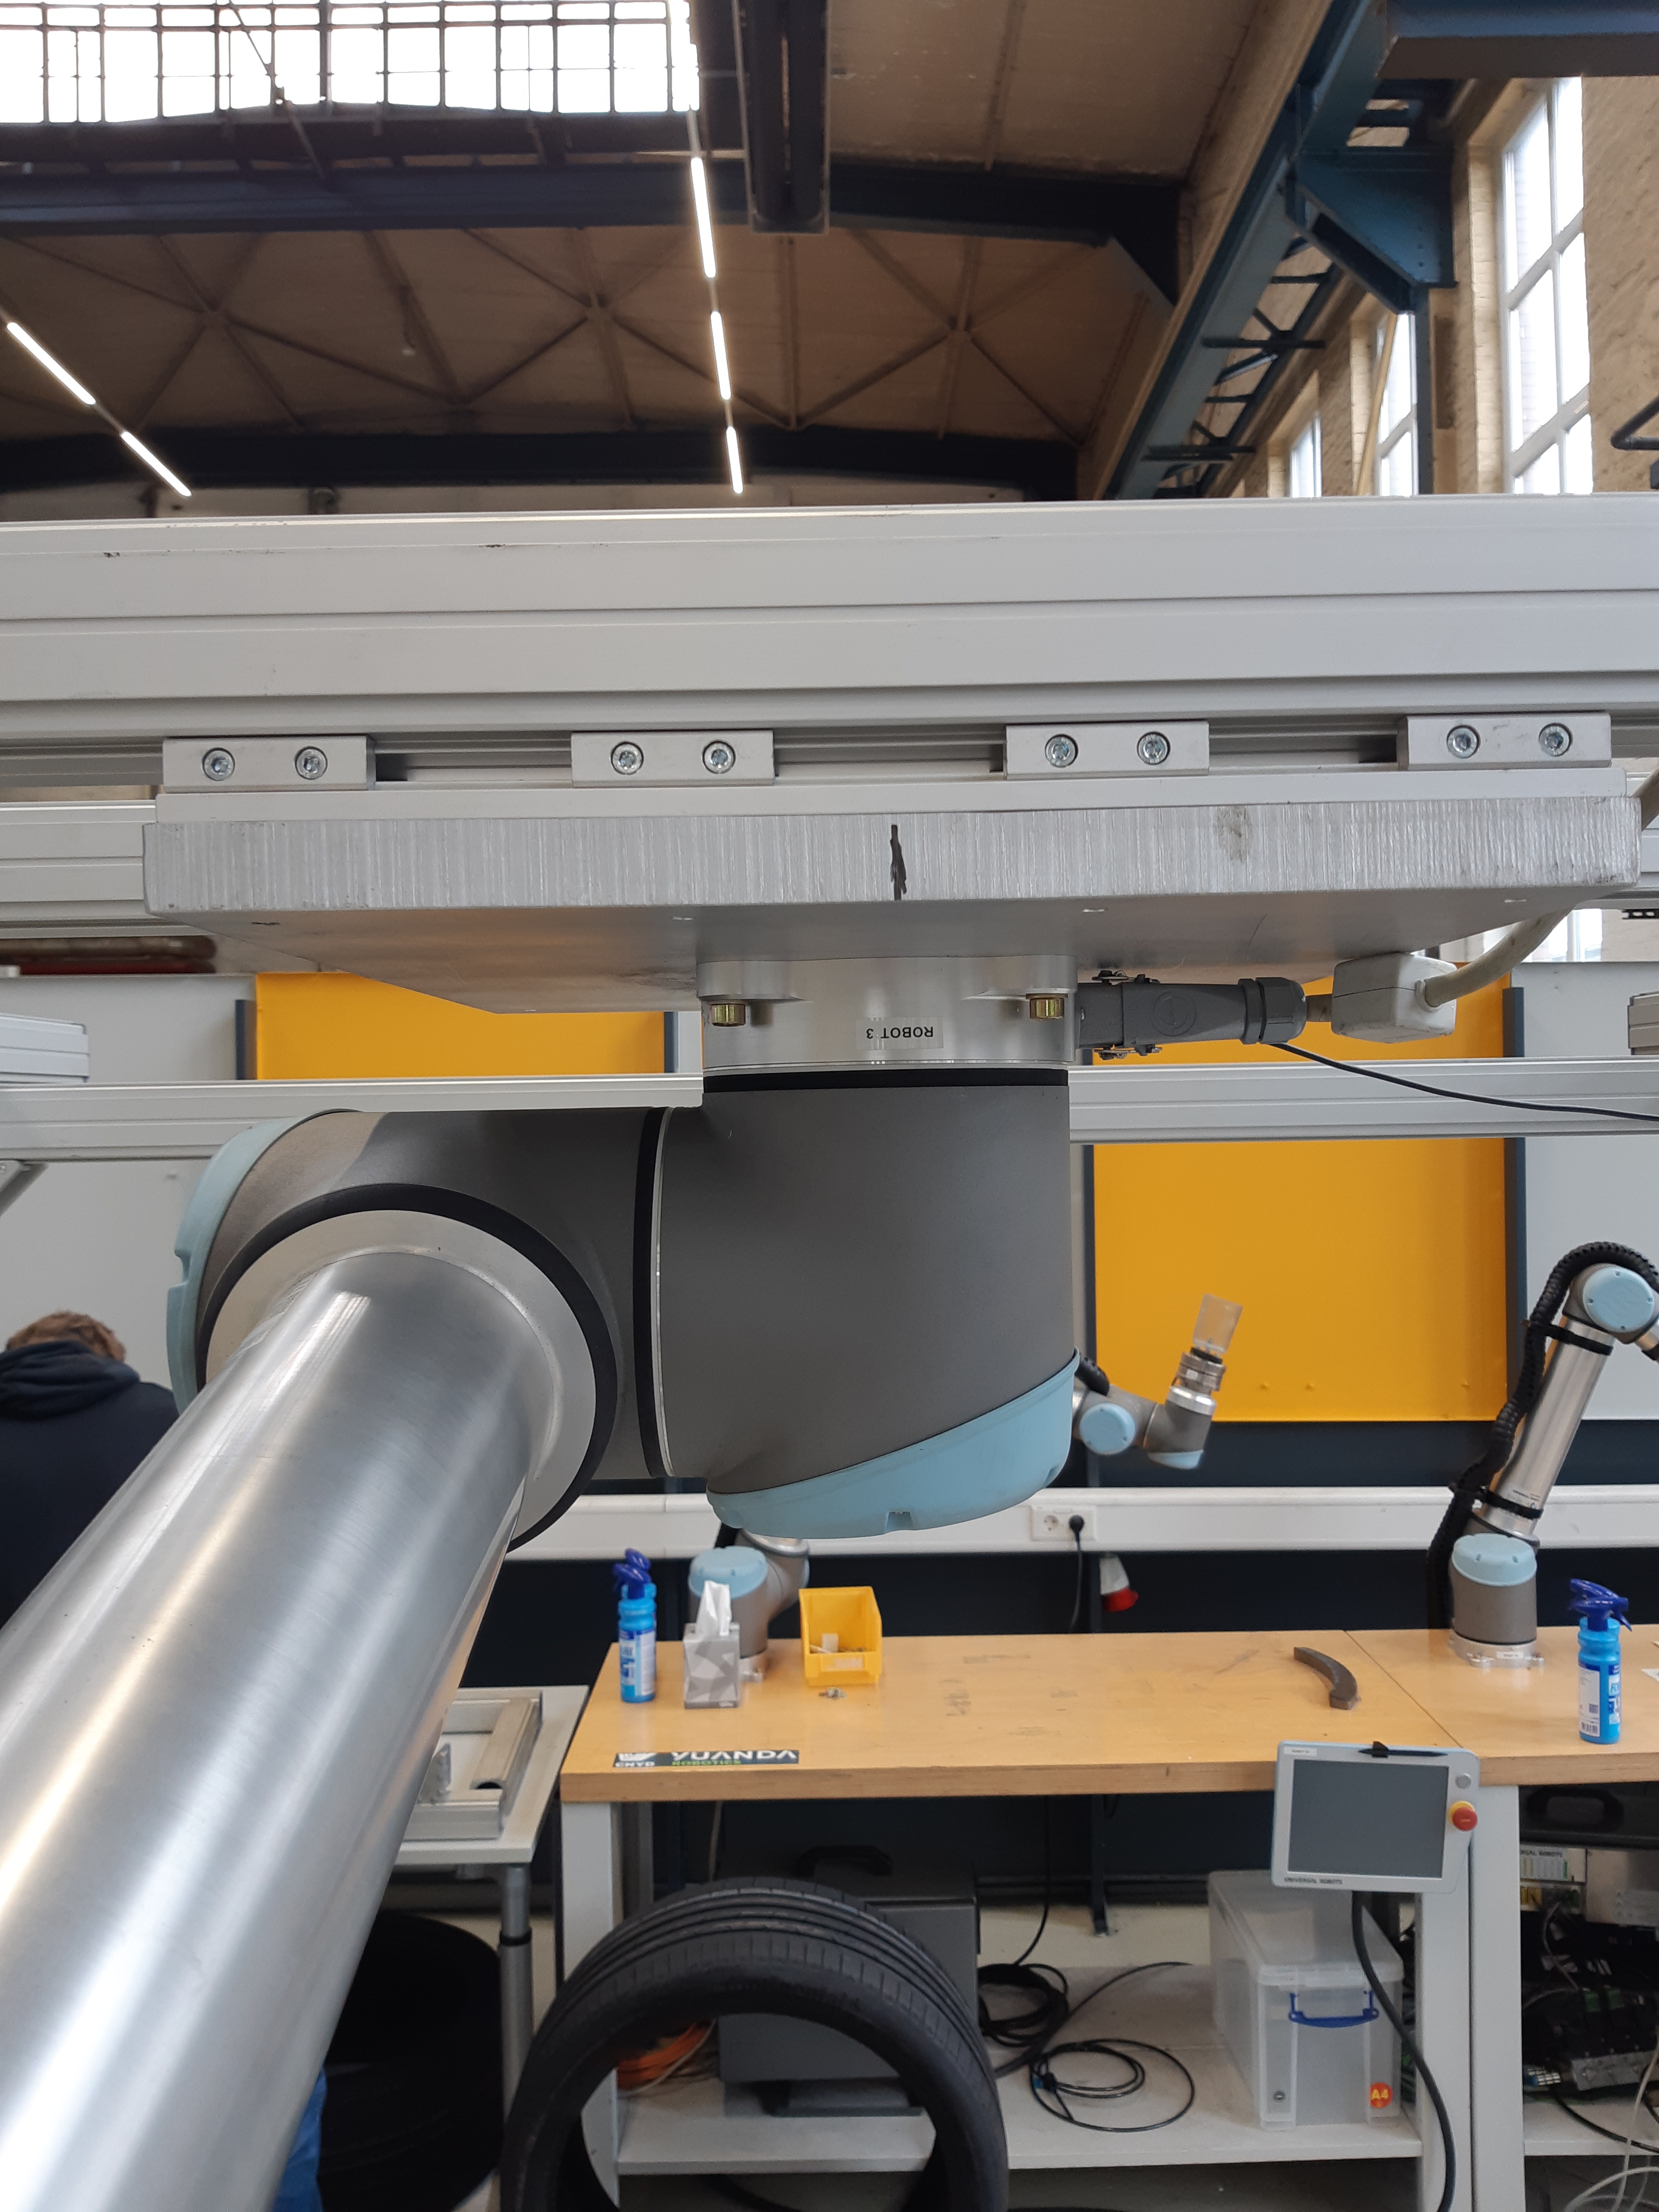
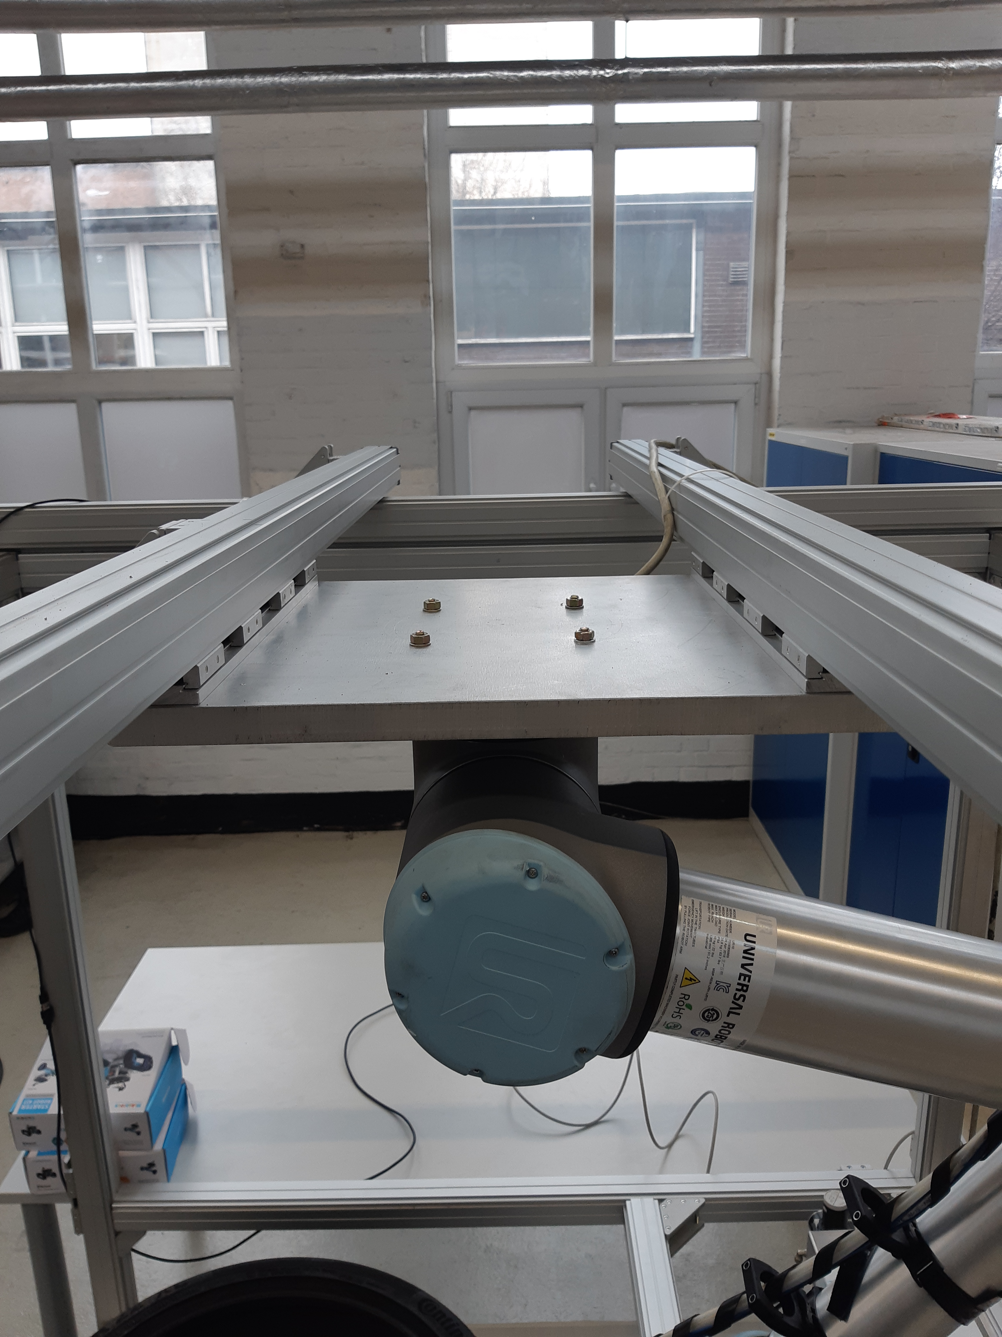
Mechanical Integration of COBOT
given frame to work with
pendent COBOT for maximal workspace
needed to engineer a mounting bracket
two sliding bars for variable position
mounted on a metal board
underneath two MonTec Bars on frame
Valuation of screw size and strength by static computing

Slide 4
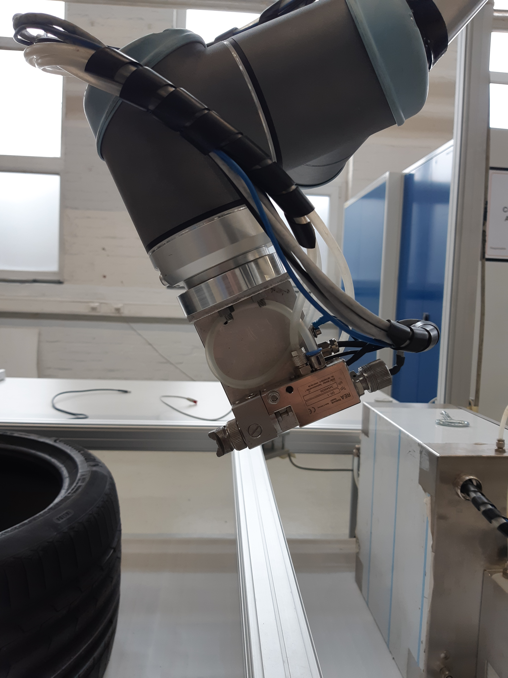
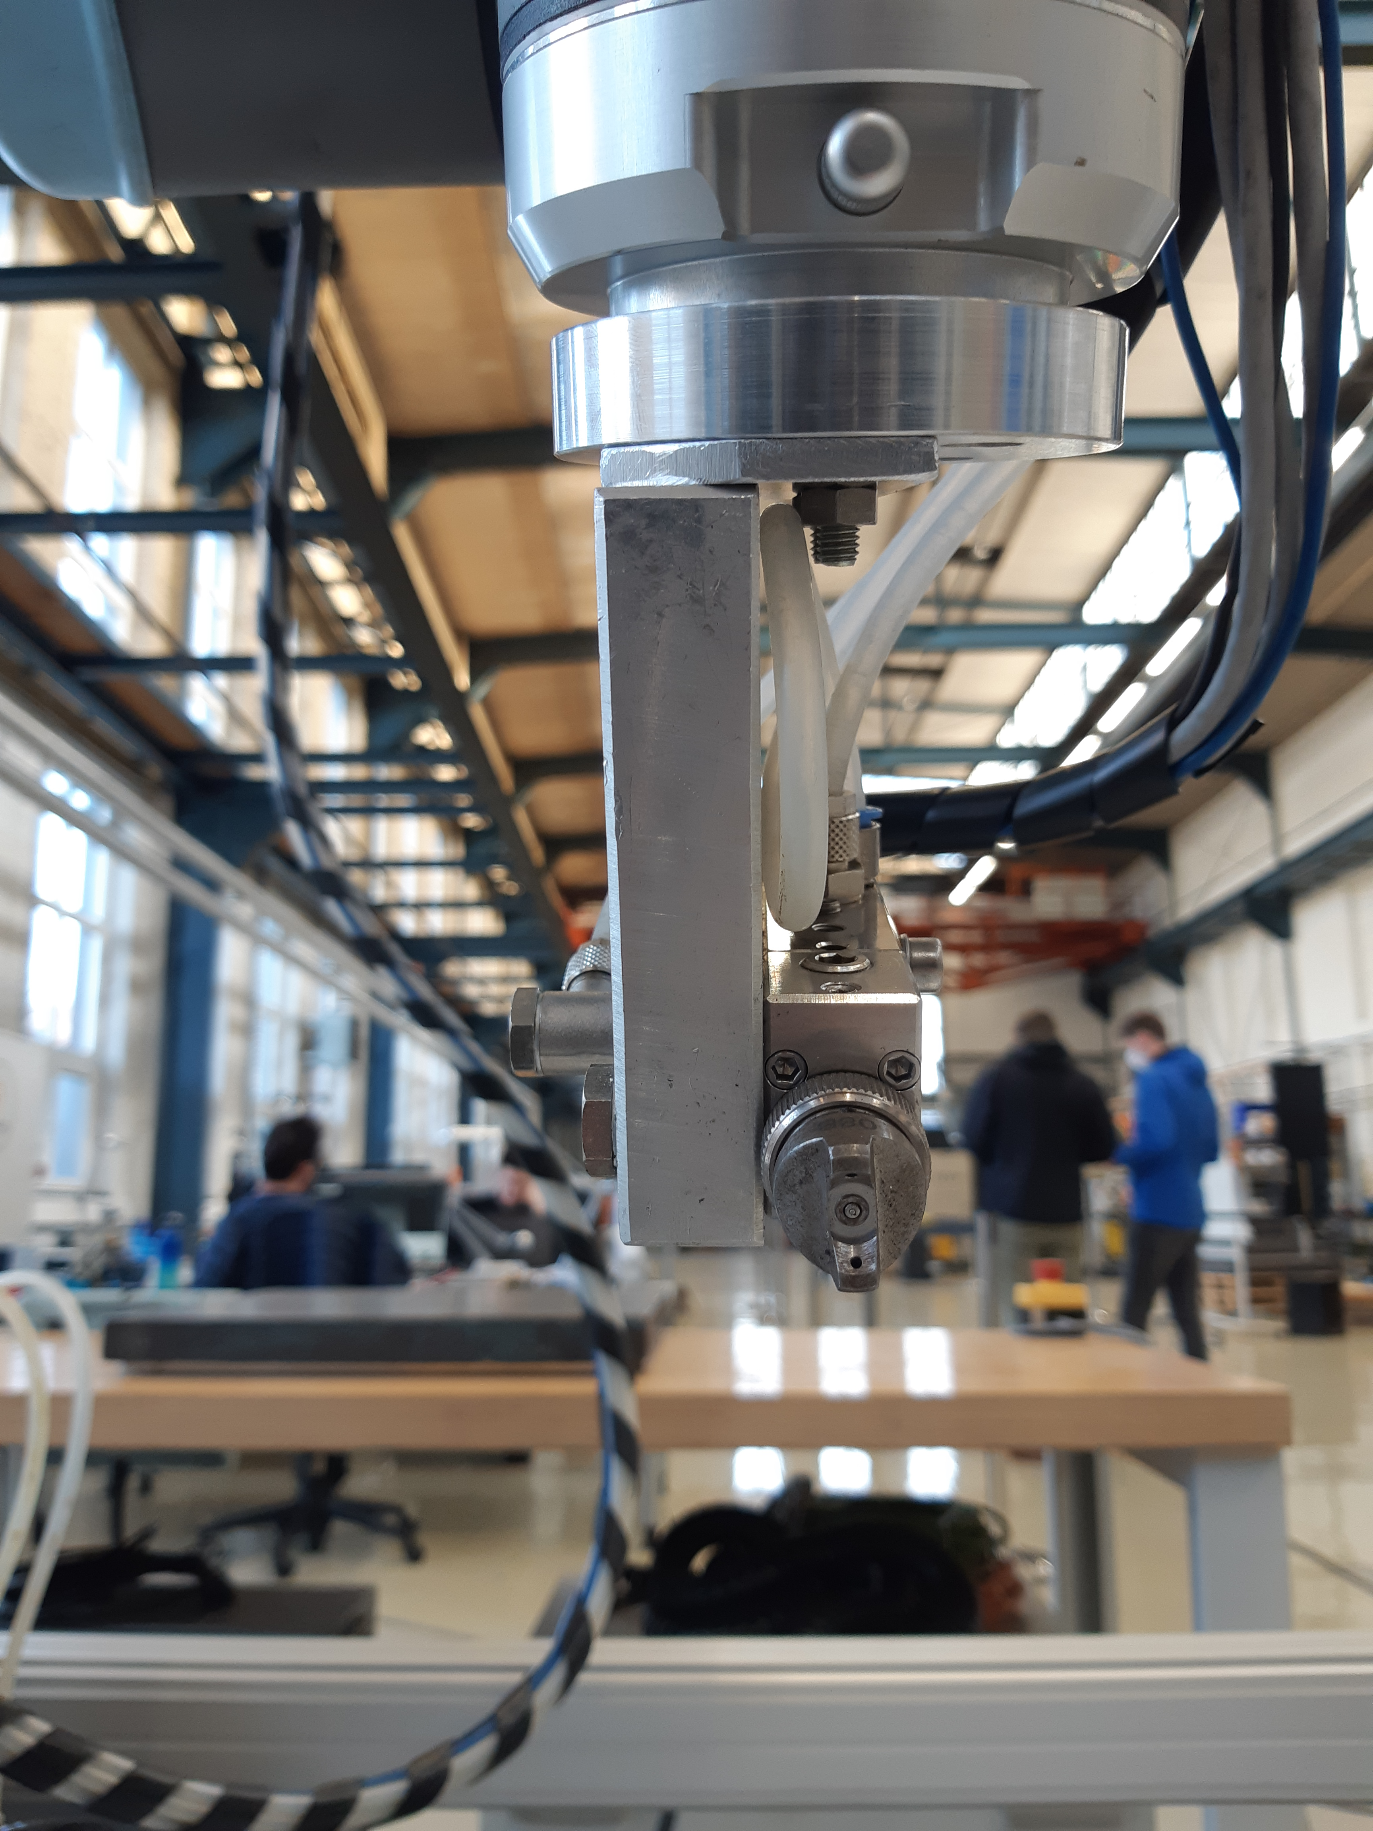
Spraying tool
given spraying tool and spraying system
mounting plate from former project
COBOT rotates the tool with the last joint
compensation of offset to arrange centric

Slide 5
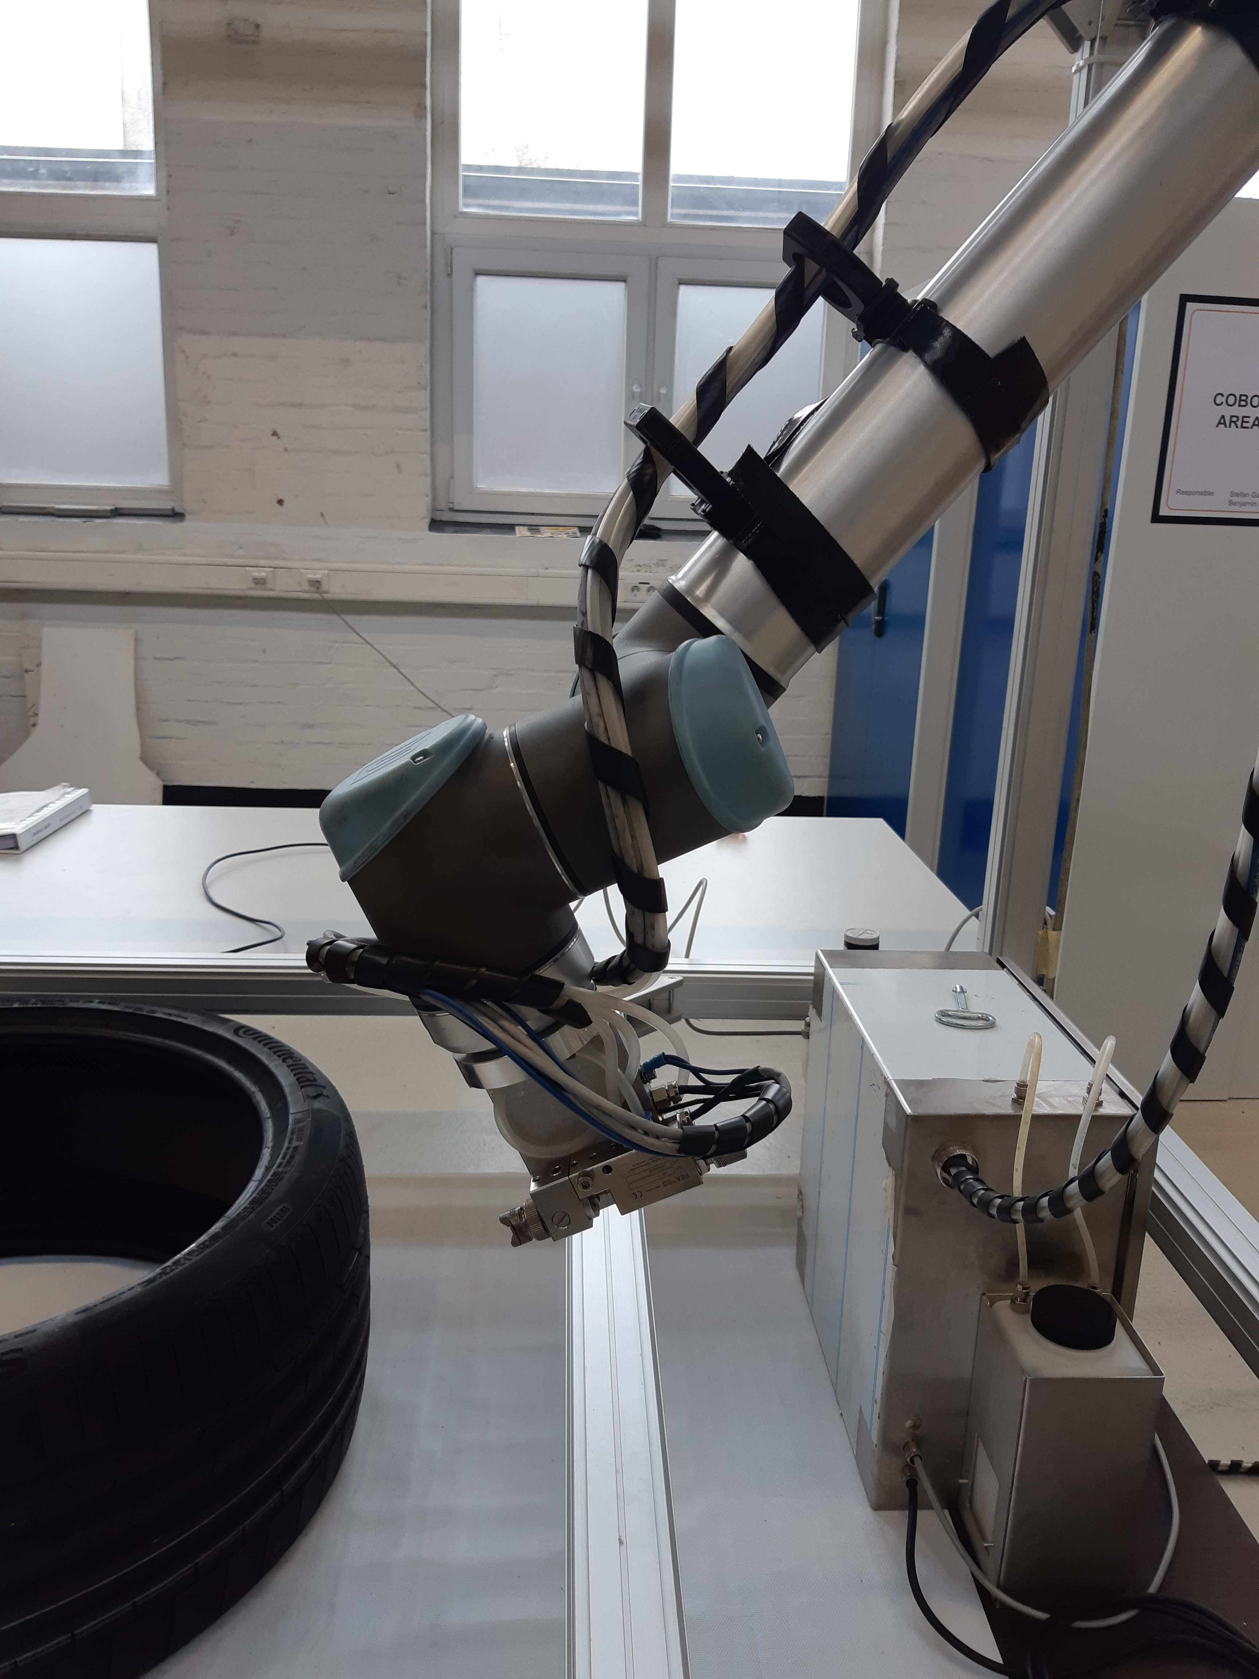
Potential for optimization
COBOT integration:
For faster movements of the COBOT, the frame needs to be more stable.
COBOT drive could be integrated into frame.
Spraying tool:
Solution for wires and hoses, which need flexible length to adjust the way of the rotation
Mounting of the tool could be simplified
Spraying drive integration

Slide 6
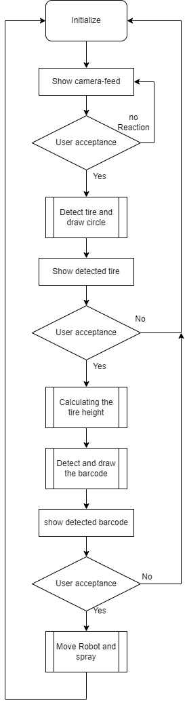
Process & Python
Tire detecting with Machine Vison (Intel Realsense D435i)
Programming in Python
Used libraries:
Open CV (for Image processing and Machine vison)
Pyrealsense2 (to use the 3D Intel Camera)
Numpy (for Math features)
PySimpleGUI (to convert Script into a user-friendly program)
Threading (to enable Multiprocessing)
Rtde_control, _io ,_receive (to actuate and control the Cobot)

Slide 7
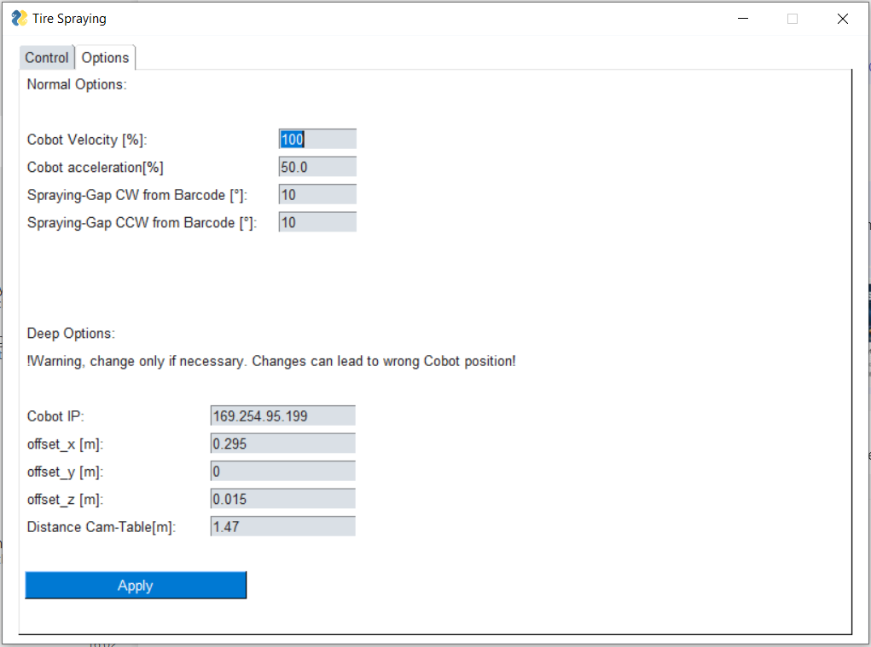
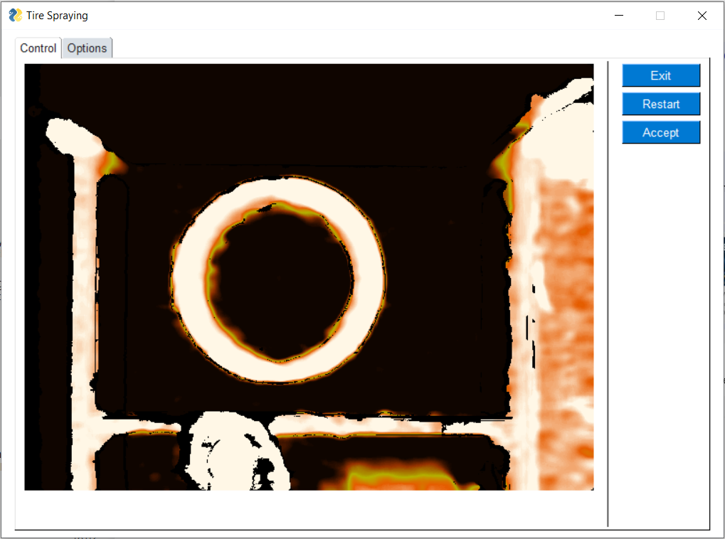
Graphical User Interface and Options

Slide 8
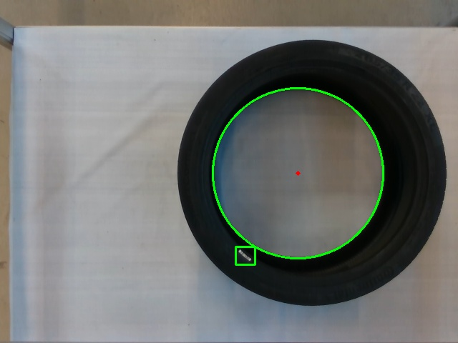
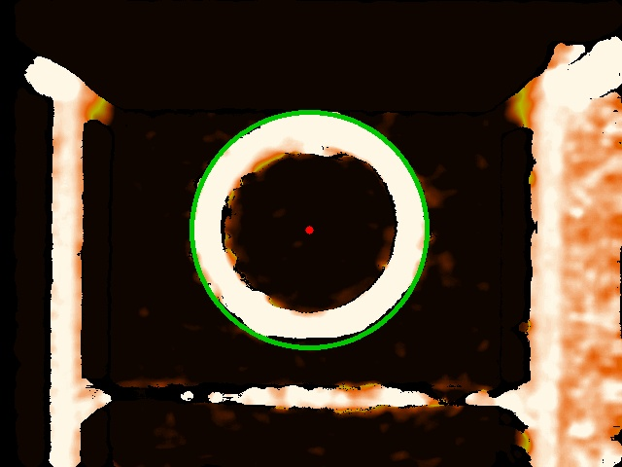
Choice of camera for the tire detection
Visual distortion can appear on the normal camera, when the Tire is not centered
Tire is correctly detected in the depth cam

Slide 9
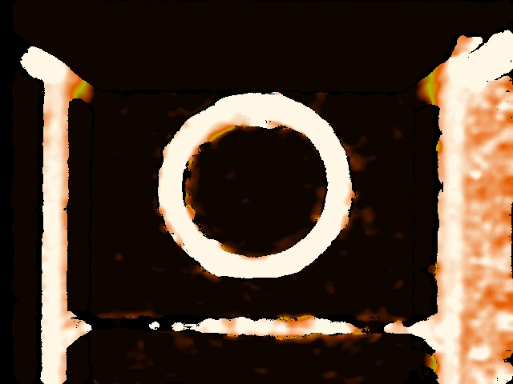
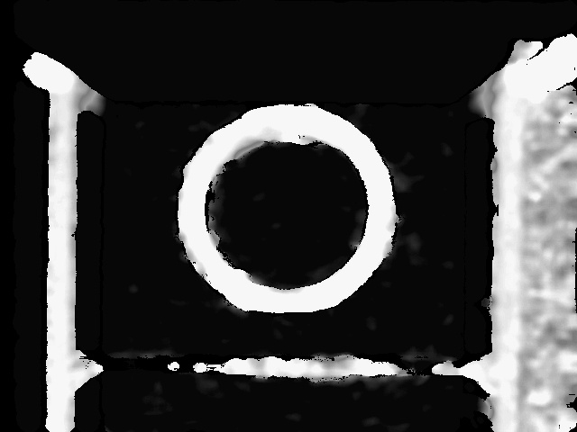

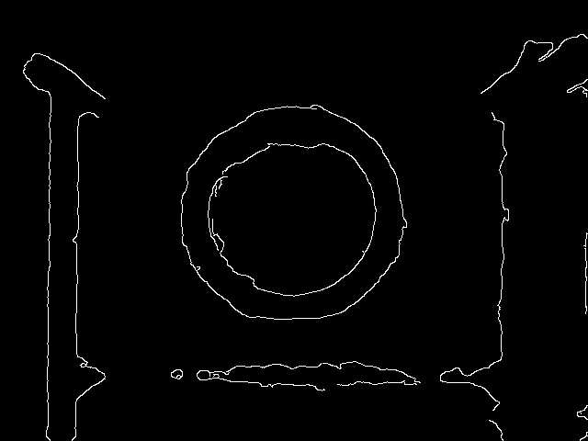
Detecting the tire
1) Get the depth cam
2) Grayscale the picture
3) Blur the picture
4) Add Canny and Threshold
5) OpenCV can detect the circle in the 4. Picture which can be shown in the original

Slide 10
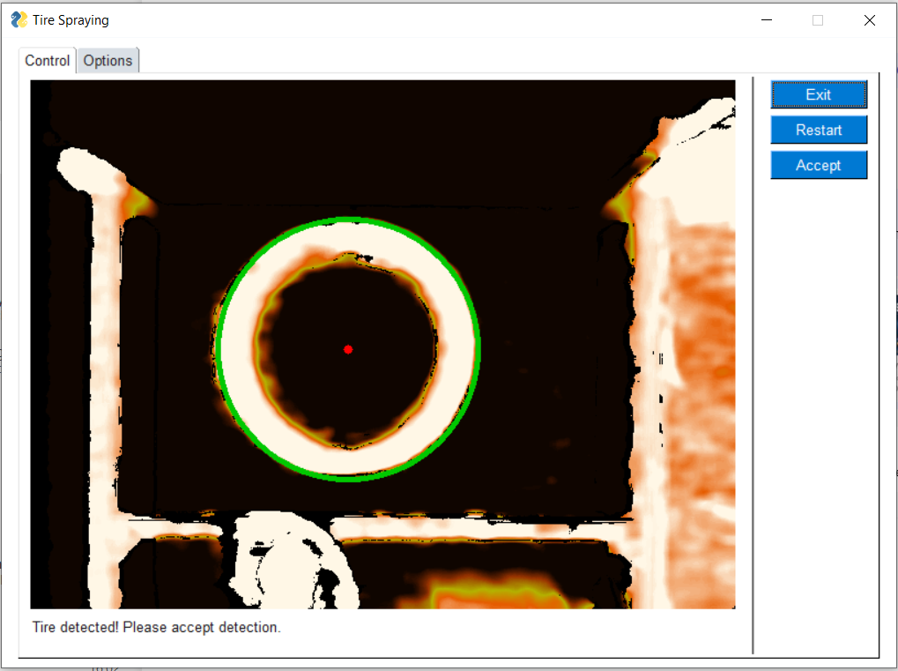
Accepting the detection
User can accept the detection to go forward, exit the application or restart the detection

Slide 11
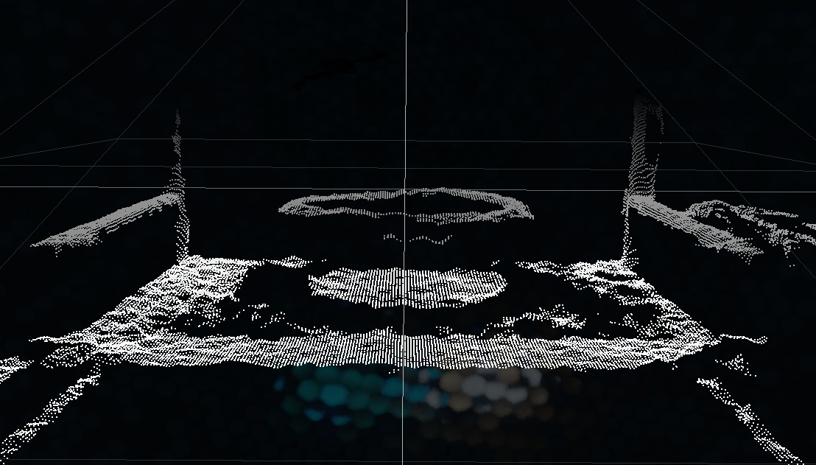
Calculating the height
The Picture of depth Cam can be interpreted as an array with a depth Value for each Pixel
This creates a Point cloud as can be seen below
To calculate the height of the Tire, we take the average height of all points in a region of interest

Slide 12
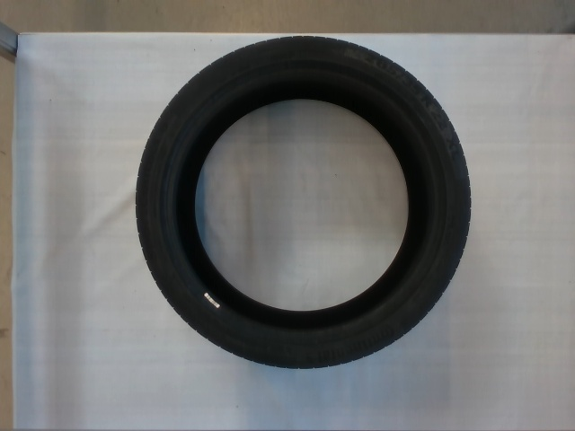
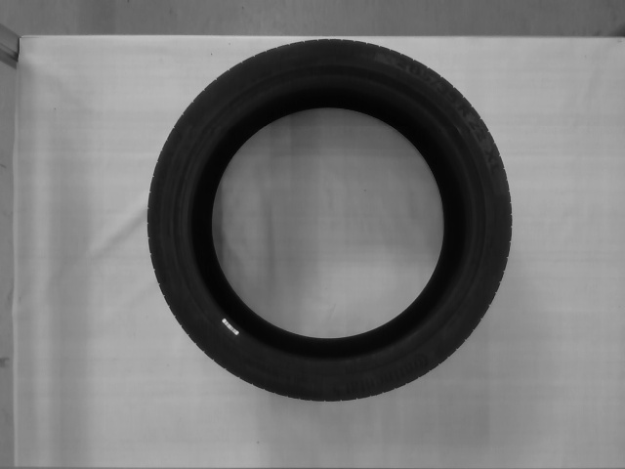


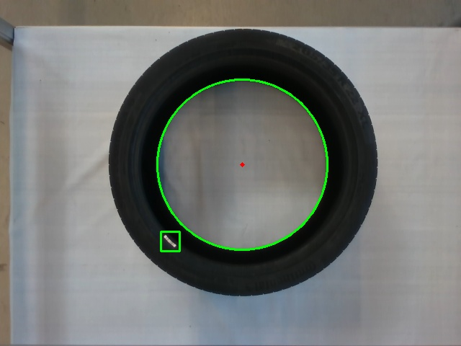
Detecting the Barcode
1) Get the normal cam
2) Grayscale the picture
3) Blur the picture
α
4) Add Canny and Threshold
5) OpenCV can detect the Barcode as the little white Square
5) The barcode position is interpreted as an angle (α)

Slide 13
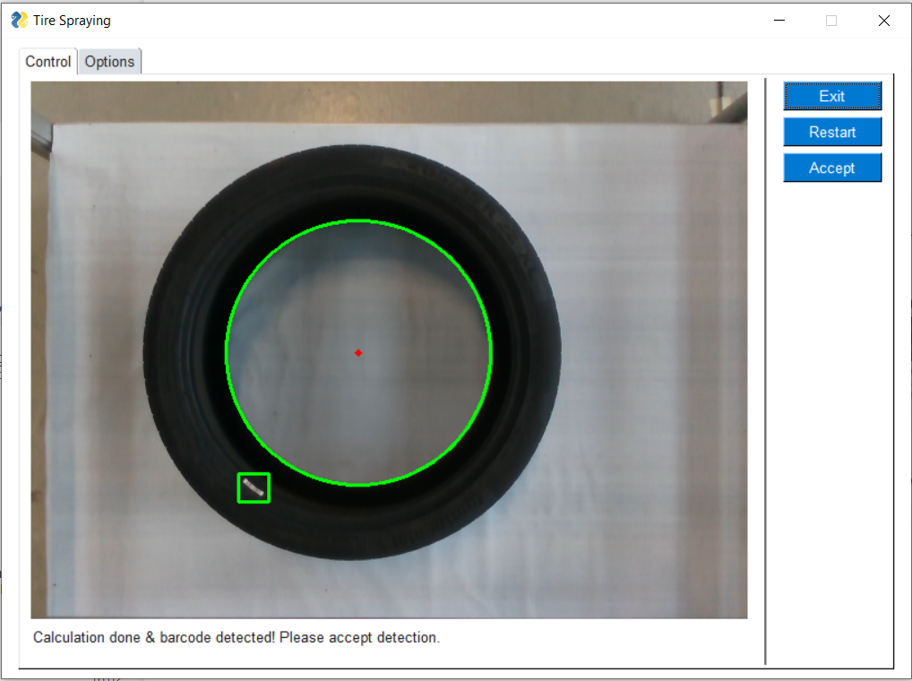
User acceptance
User can accept the detection to go forward, exit the application or restart the detection

Slide 14
Moving the Robot and Spraying the Tire
To move the Cobot, all points in pixels need to be converted into points in the room
A algorythm from the pyrealsense2 library is used
These Points are in the coordinate system of the camera and are converted into coordinates of the Cobot coordinate system
Coordinate transformation
The position of the detected barcode limits the spraying area
After this calculations, the Cobot starts the automated spraying

Slide 15
Time for a live Demo!

Slide 16
Thank you for your attention!
Contact:
lion.ratayczak@conti.de
leon.book@conti.de

